Slide 1
ECONOMY OF INDIAN STATES A CASE STUDY
BY ABHIJIT BARUA(2K19/MC/003)
AVIKAL GOEL(2K19/MC/028)

Slide 2
OVERVIEW
The economic and demographic overview of India.
to analyse the various source of income (and the sector involved) of people of the different states of the nation and display them in a systematic and organized manner.

Slide 3
INDEX
Economy of Delhi. Page 2-16
Economy of Tamil Nadu. Page 16-30
Tamil Nadu vs Delhi. Page 30-53
Conclusion page 54-55

Slide 4
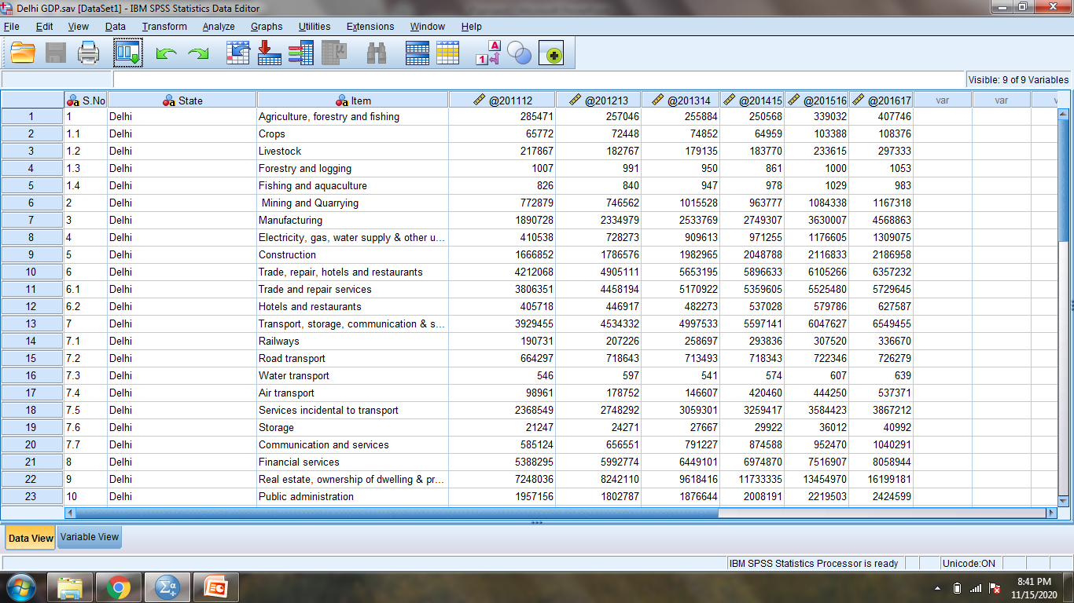
DELHI

Slide 5
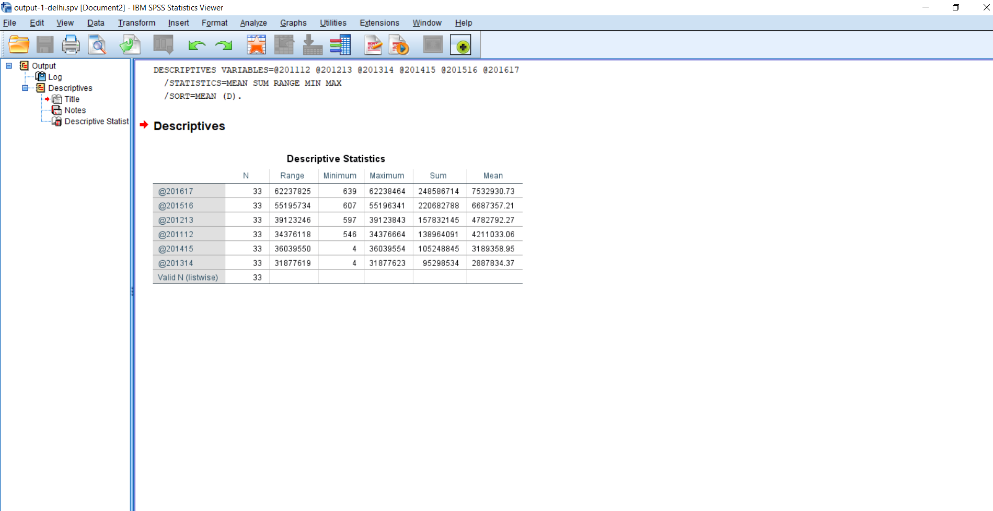
SPSS VIEW ON THE DATA COLLECTED

Slide 6
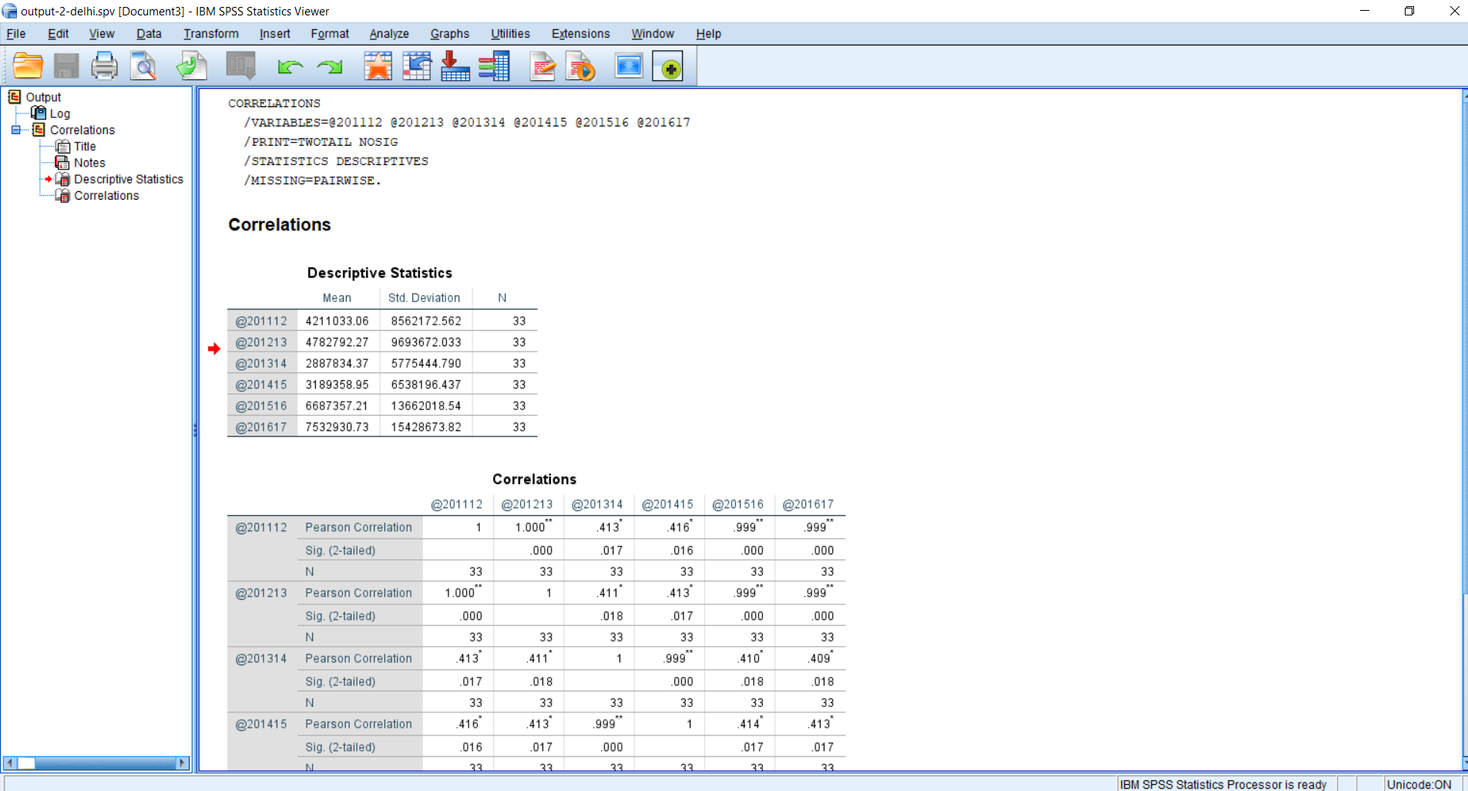

Slide 7
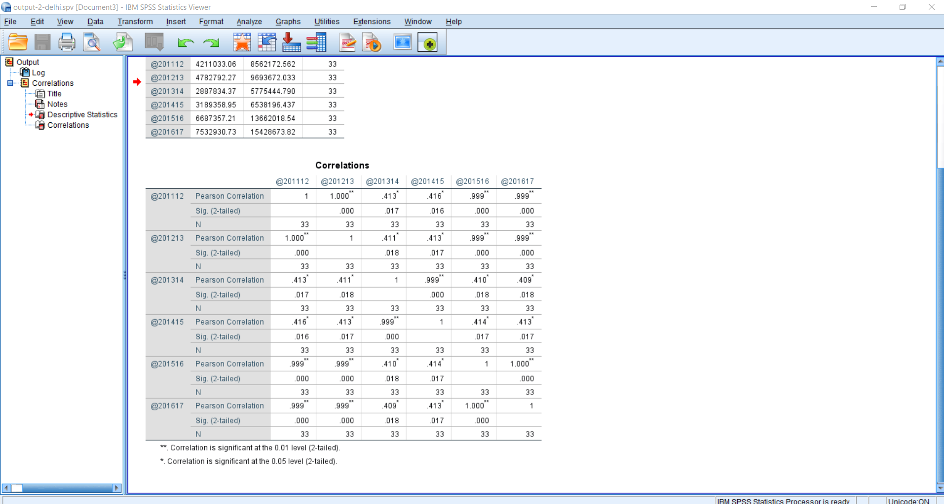

Slide 8
GDP OF DELHI THROUGH
STATS

Slide 9
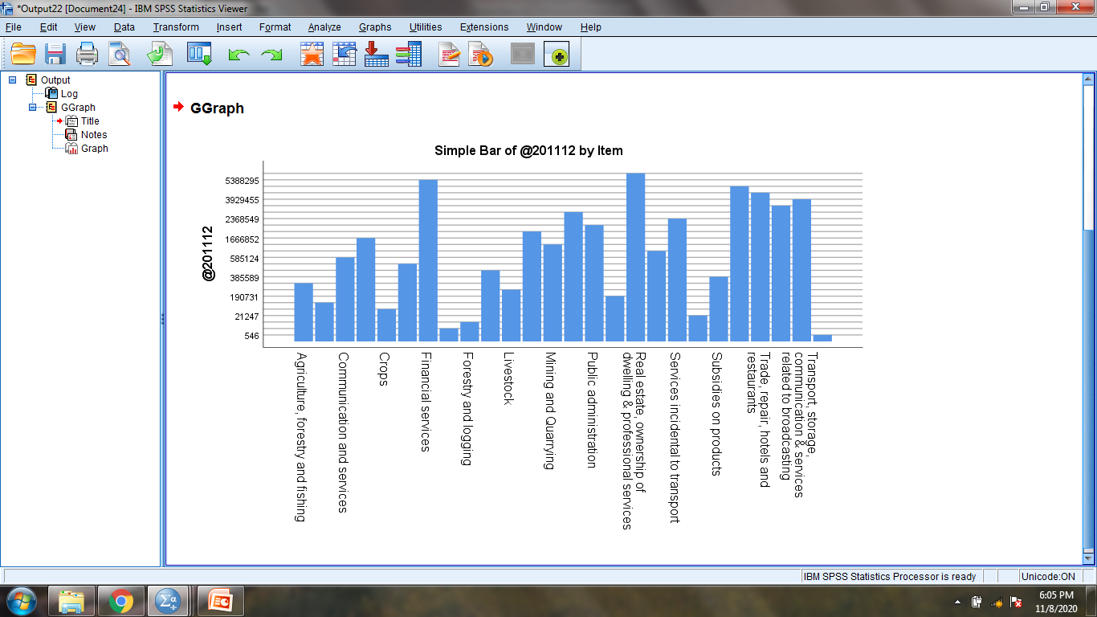

Slide 10
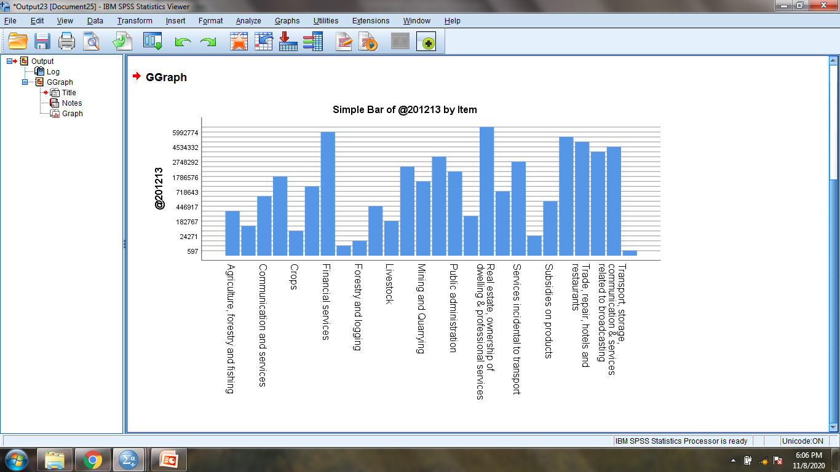

Slide 11


Slide 12
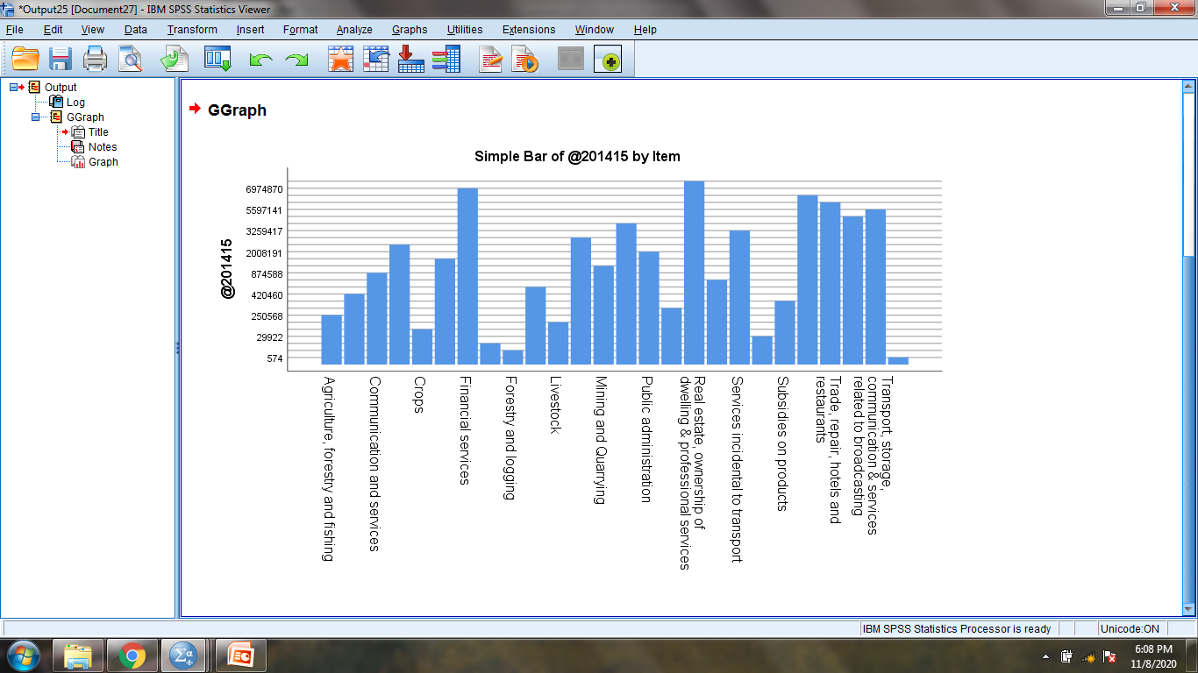

Slide 13
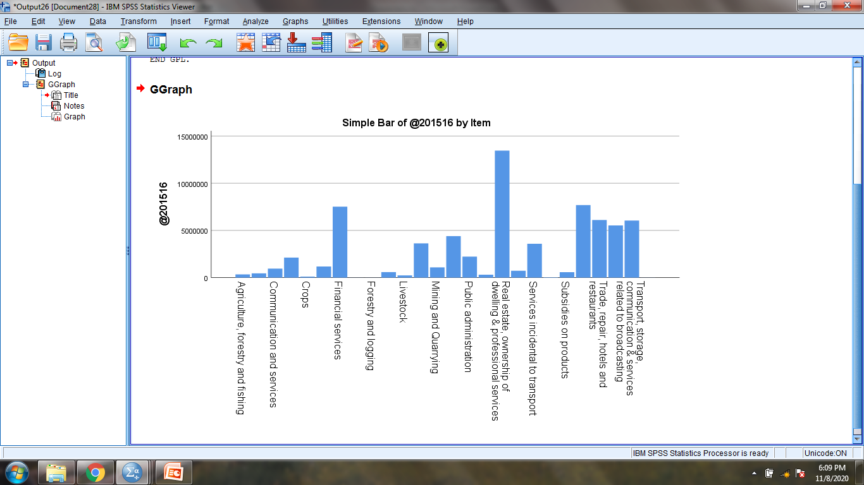

Slide 14
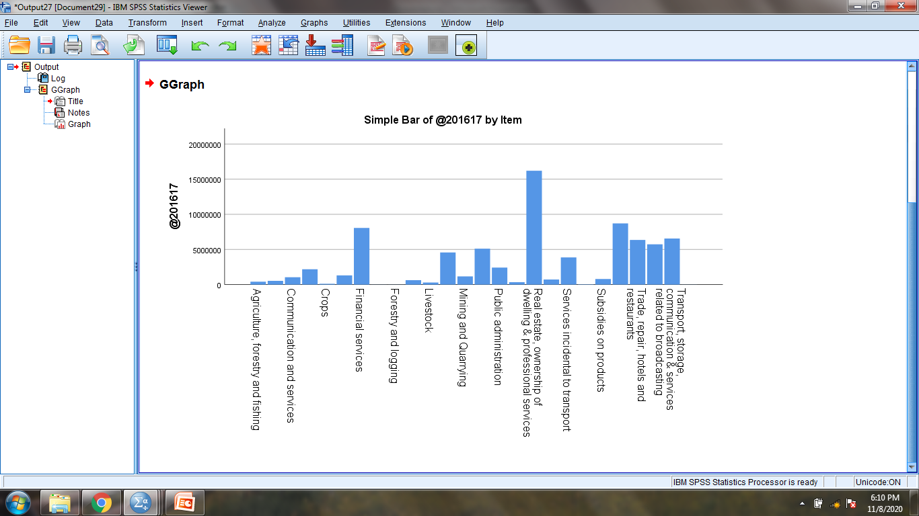

Slide 15
MASTER GRAPH:- SHOWING
YEAR-BY-YEAR STATS
TOGETHER

Slide 16
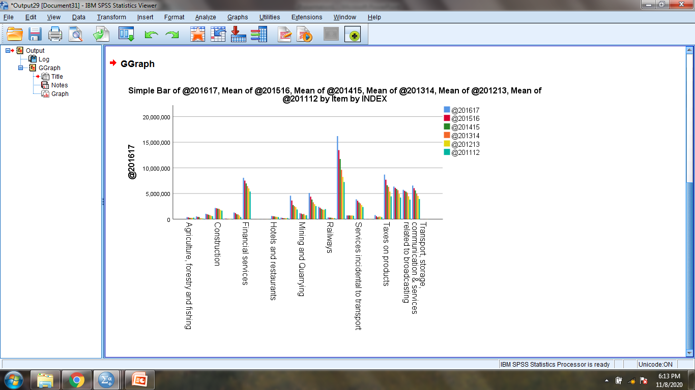

Slide 17
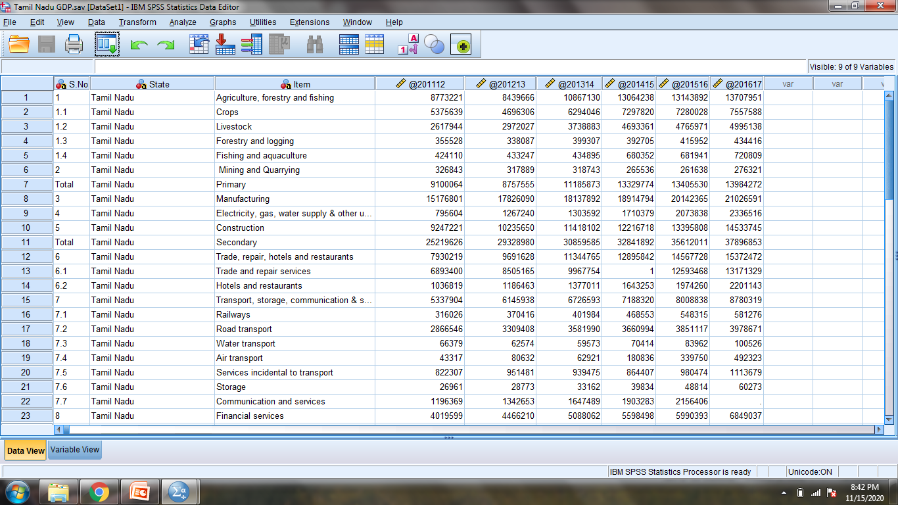
TAMIL NADU

Slide 18
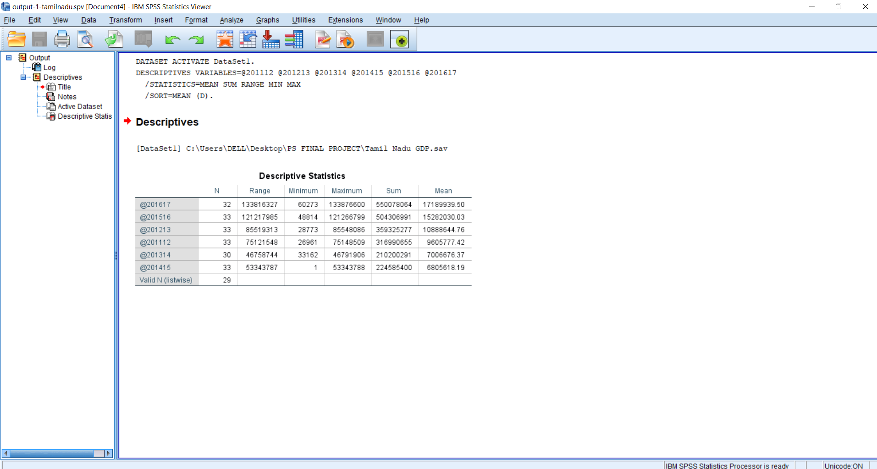

Slide 19
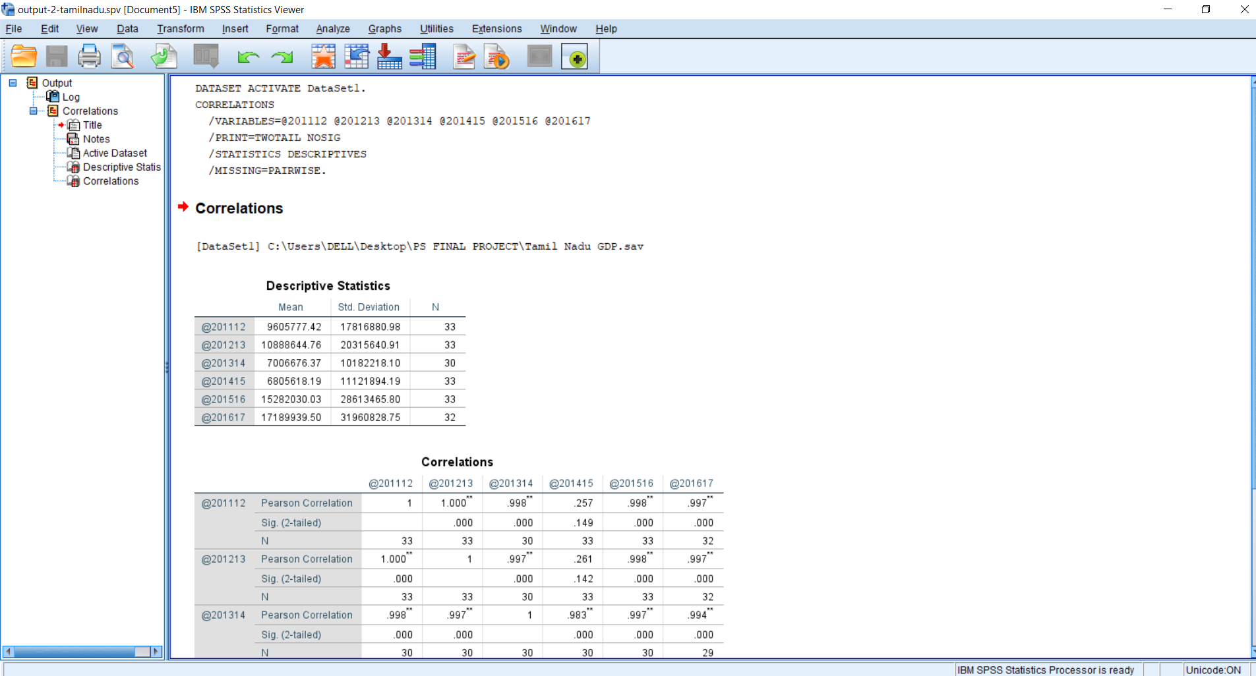

Slide 20
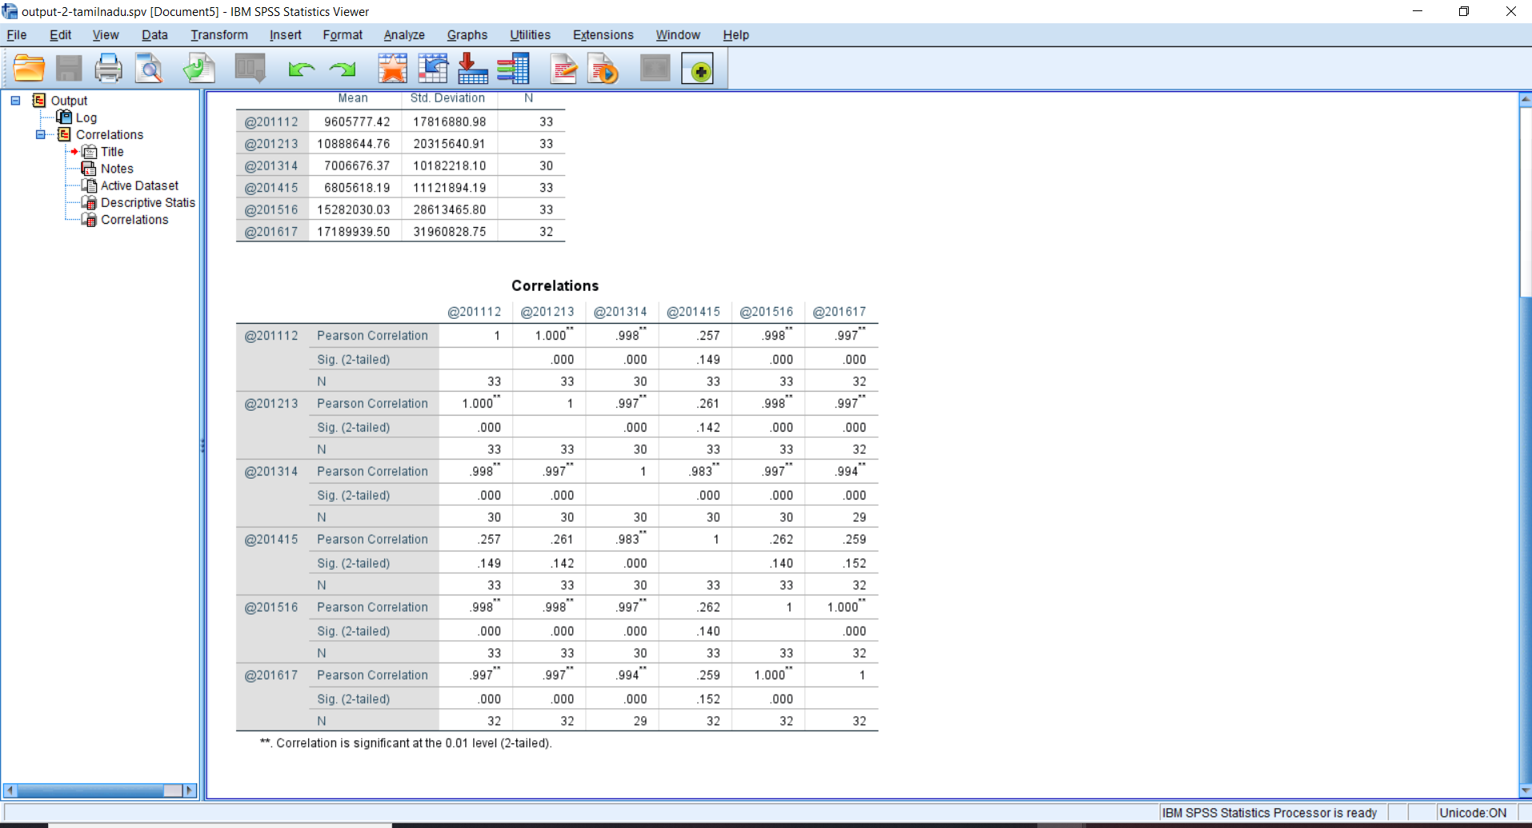

Slide 21
GDP OF TAMIL NADU
THROUGH
STATS

Slide 22
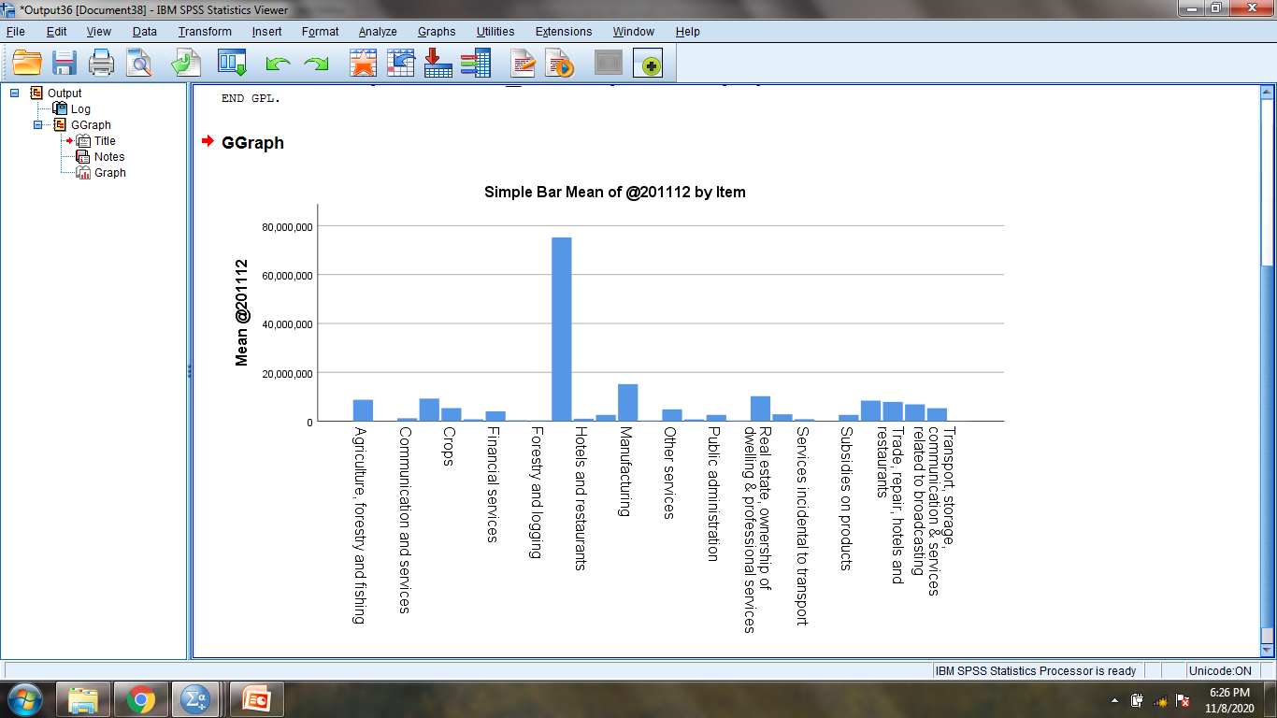

Slide 23
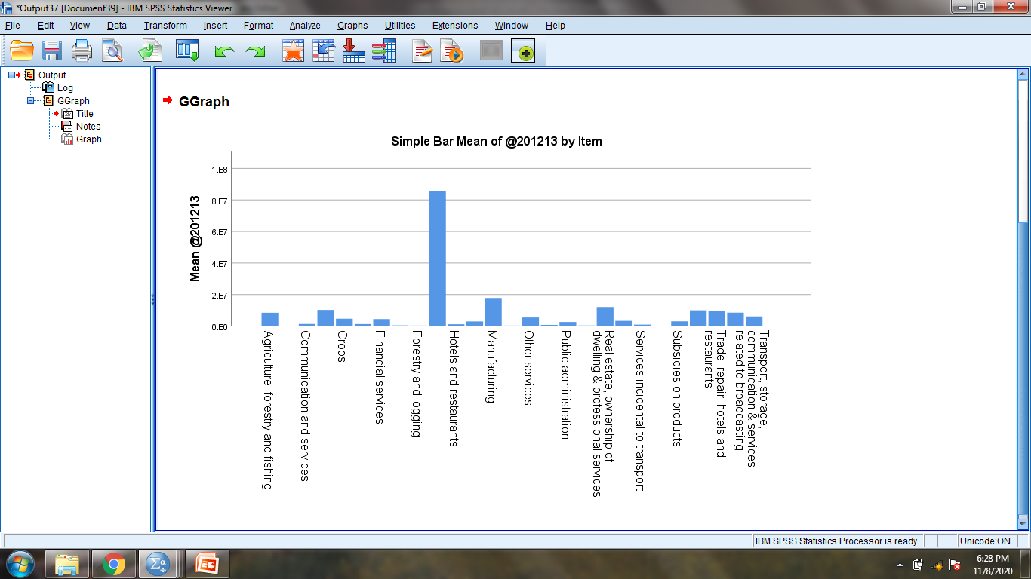

Slide 24
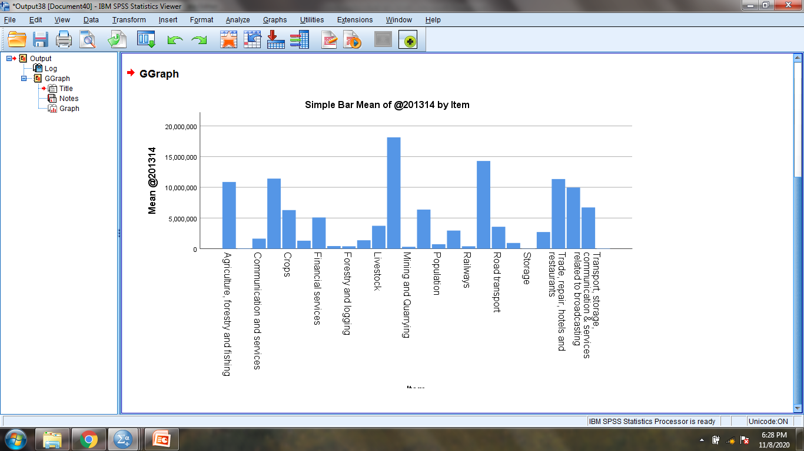

Slide 25
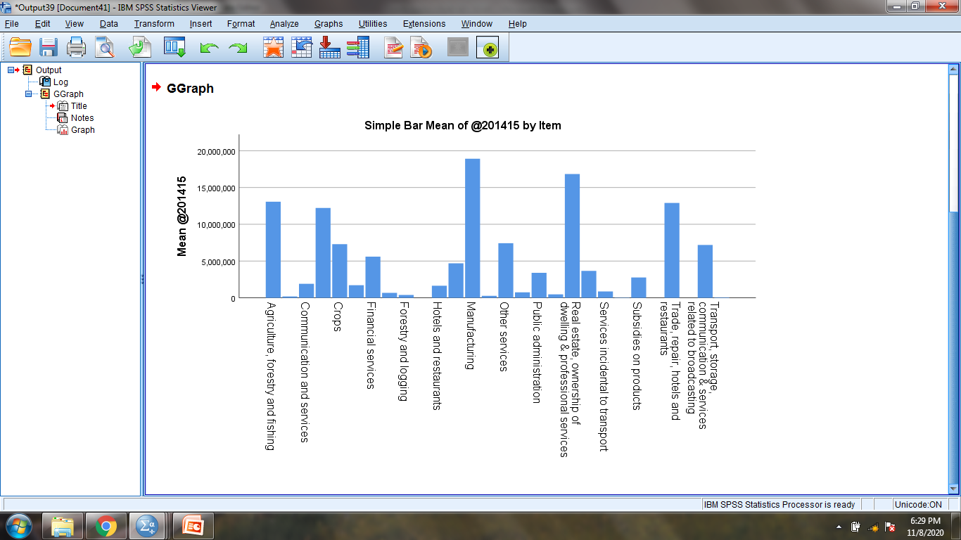

Slide 26
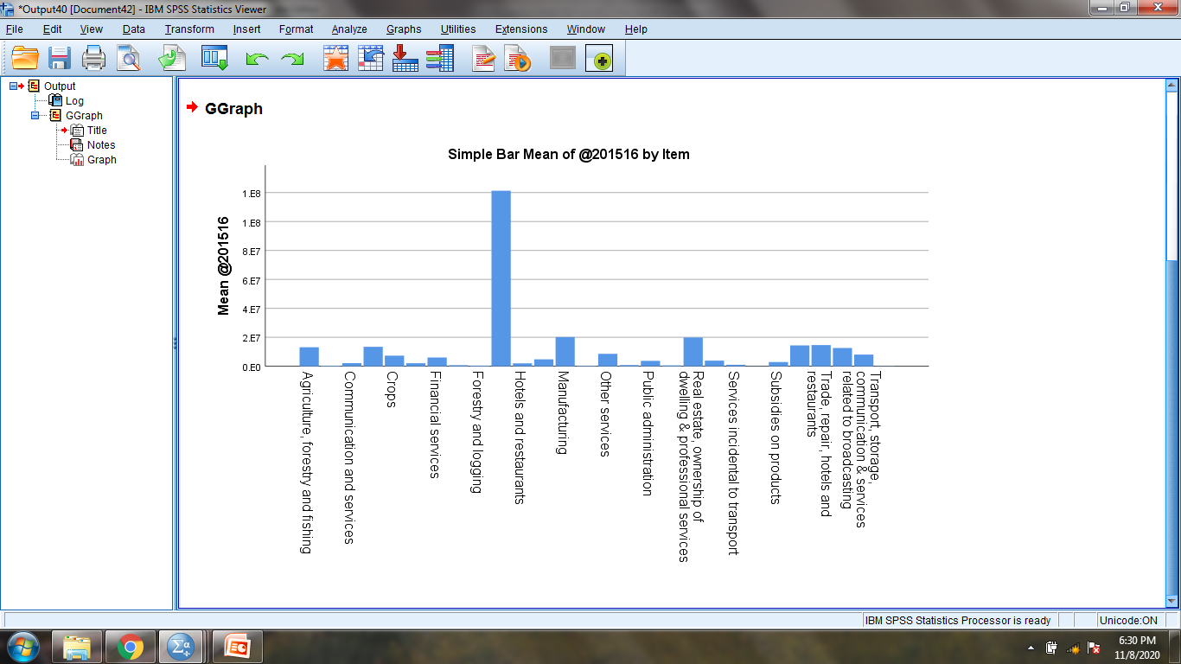

Slide 27
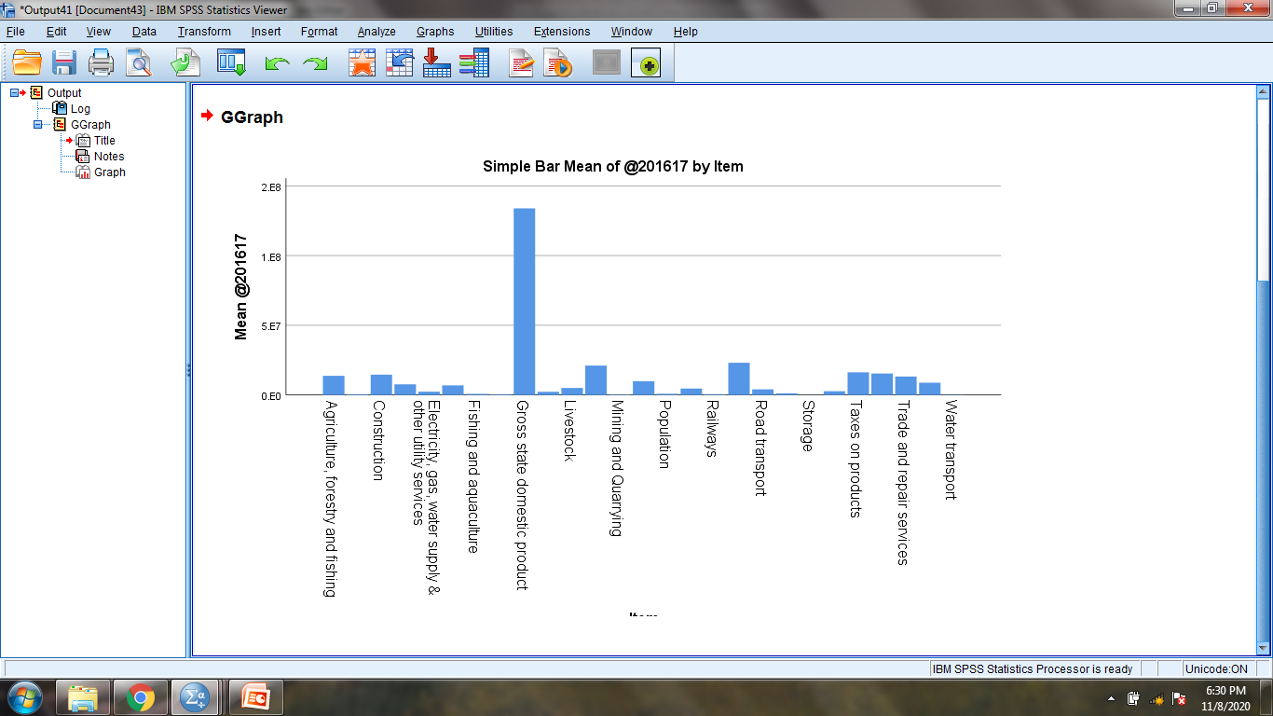

Slide 28
MASTER GRAPH:- SHOWING
YEAR-BY-YEAR STATS
TOGETHER

Slide 29
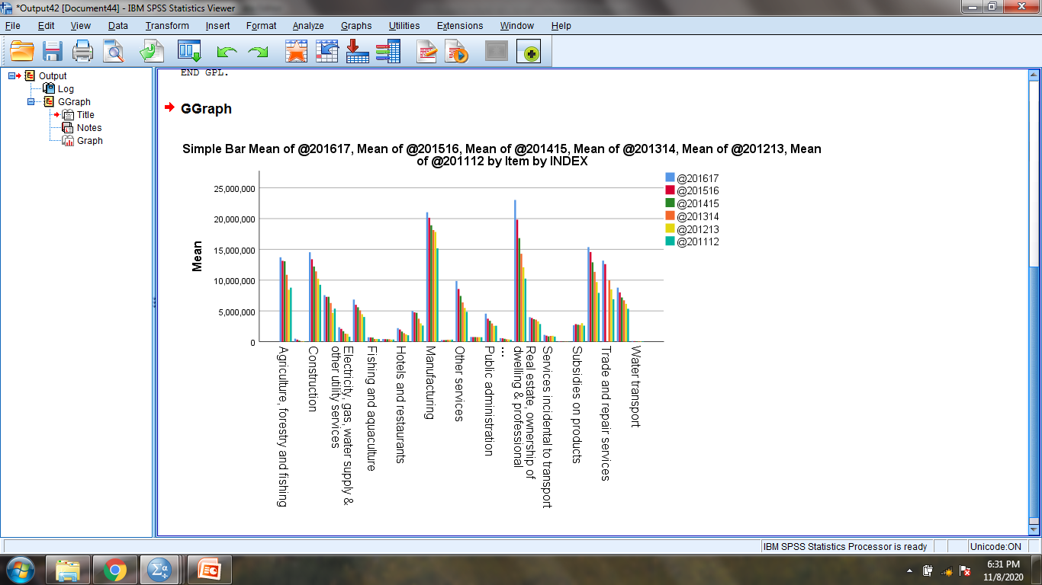

Slide 30
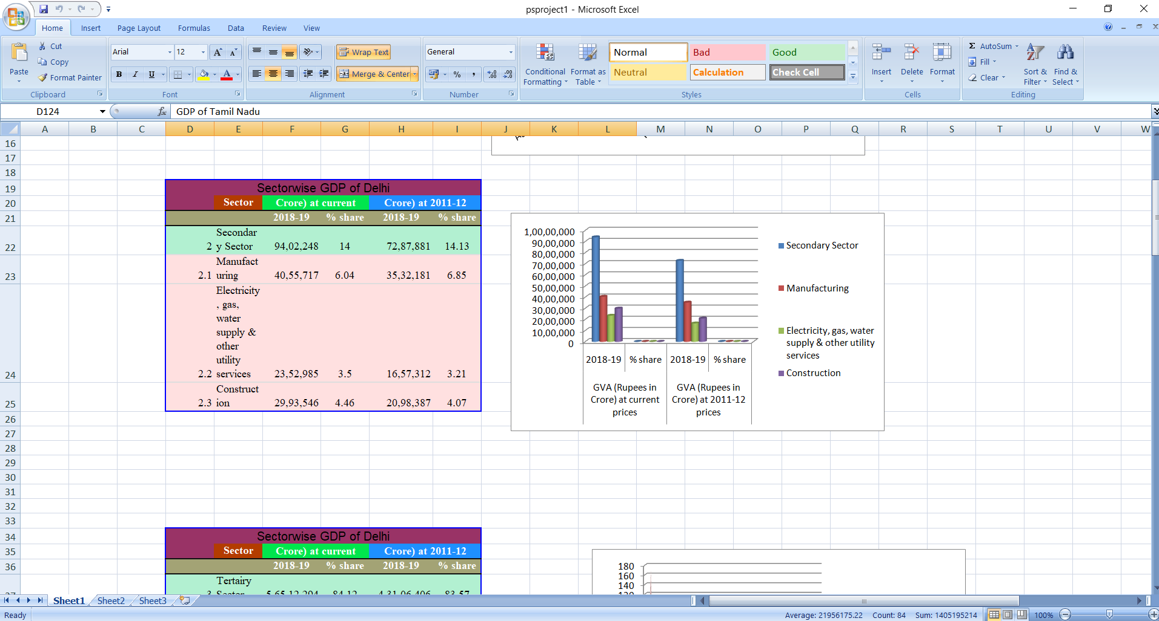
DELHI VS TAMIL NADU

Slide 31
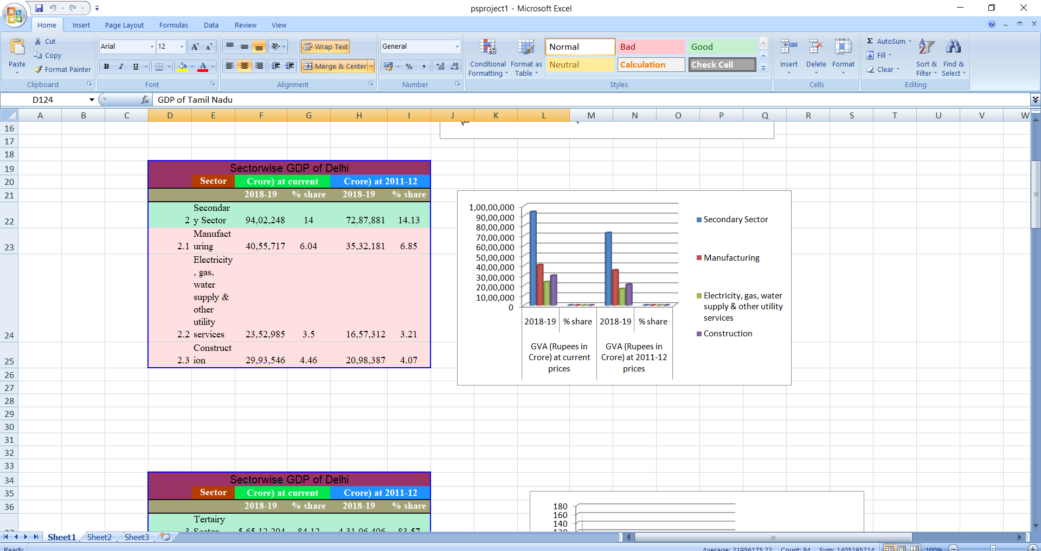

Slide 32
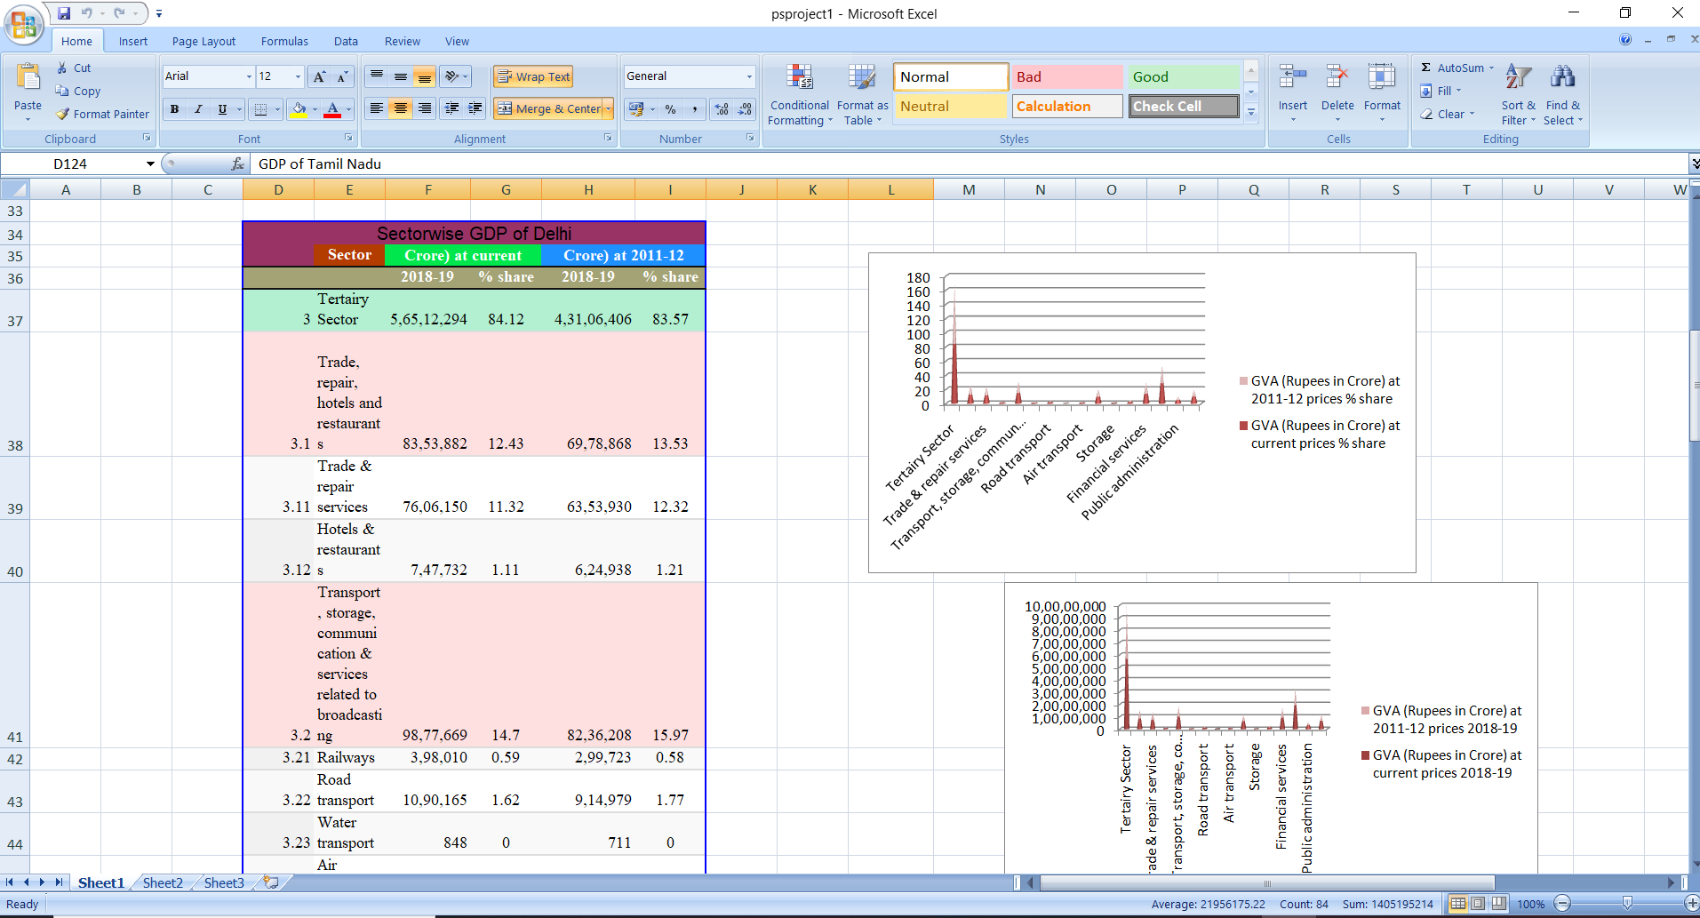

Slide 33
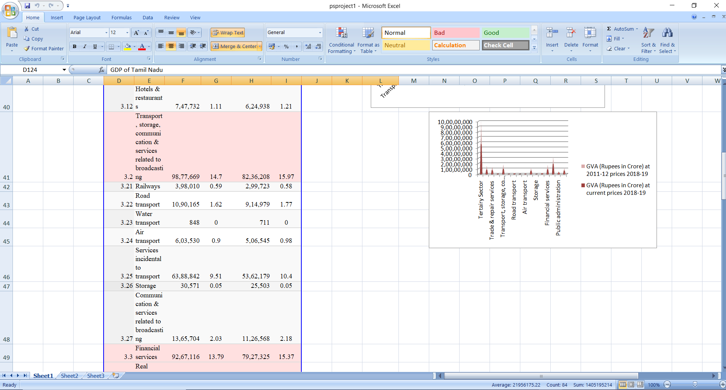

Slide 34
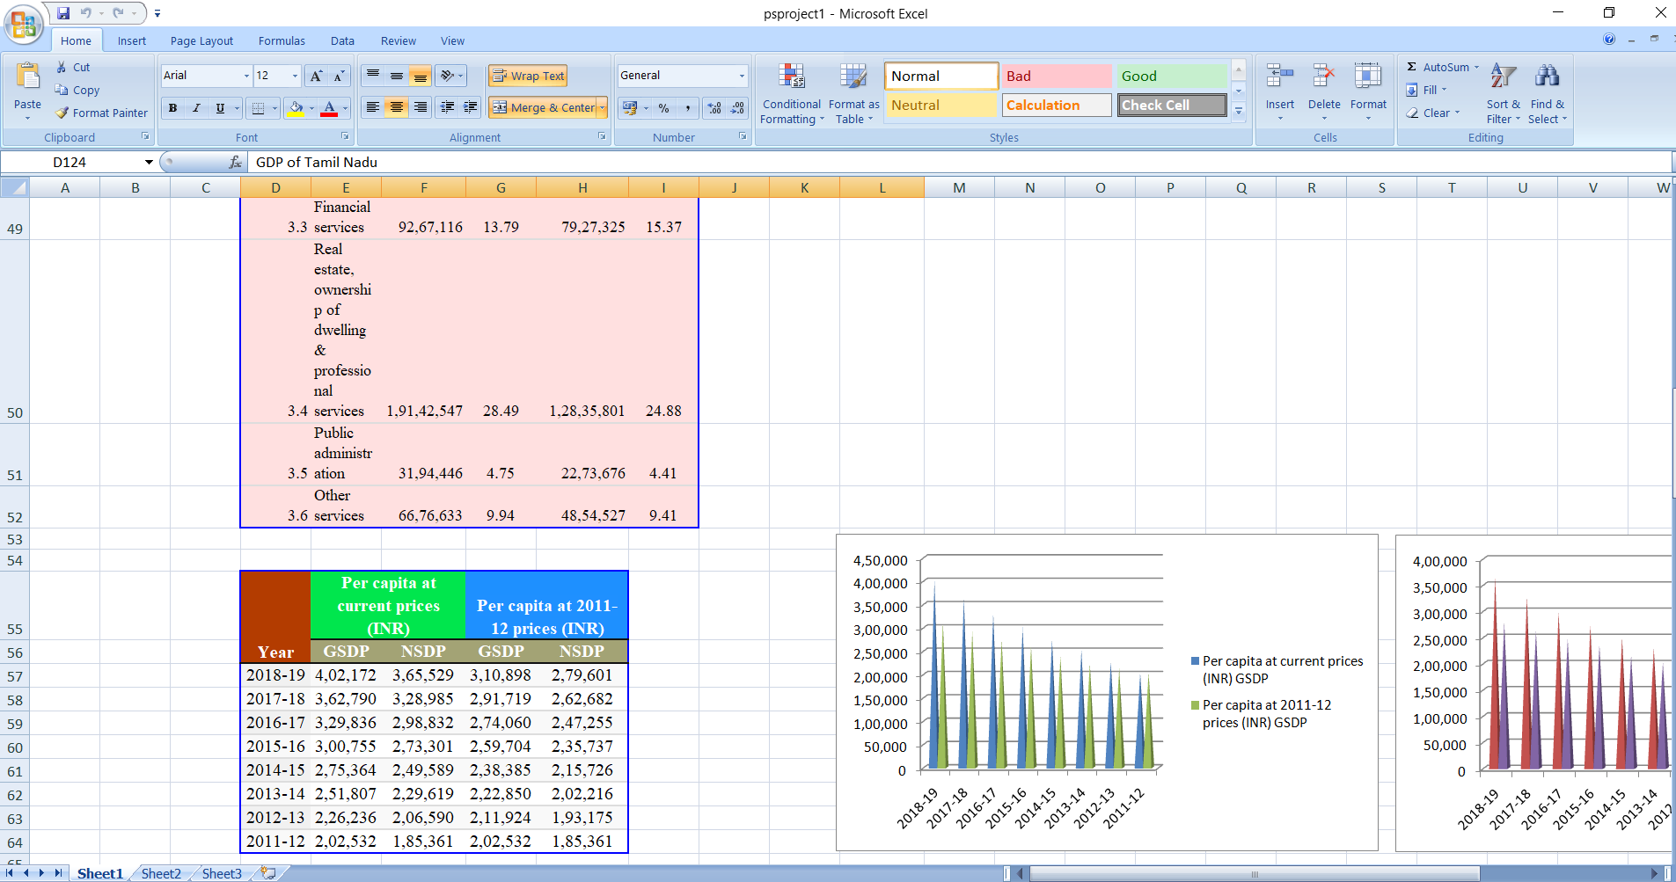

Slide 35
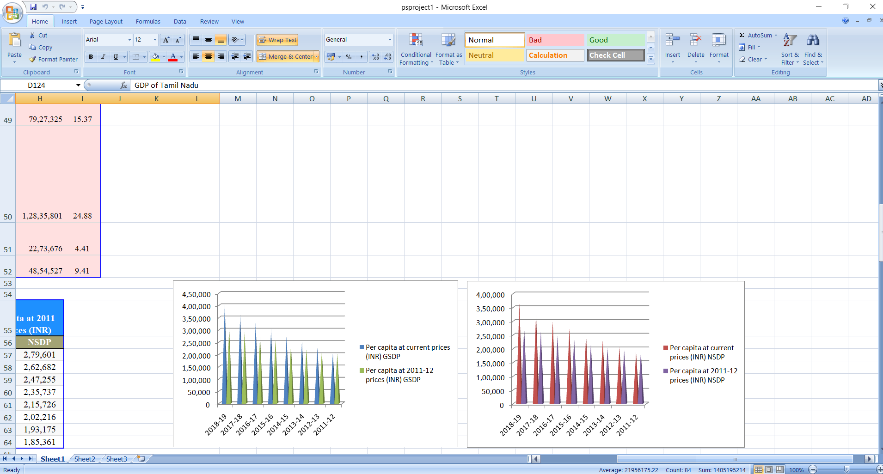

Slide 36
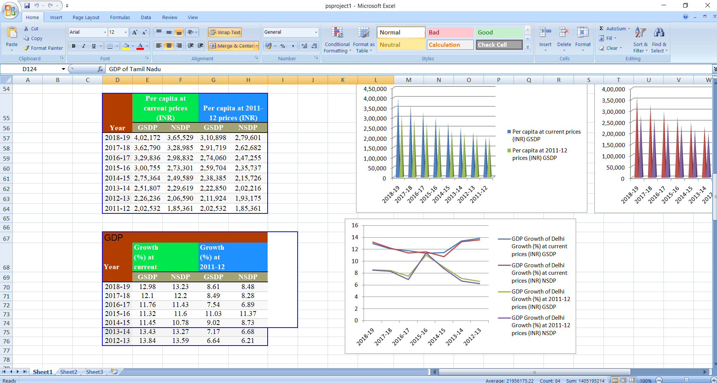

Slide 37
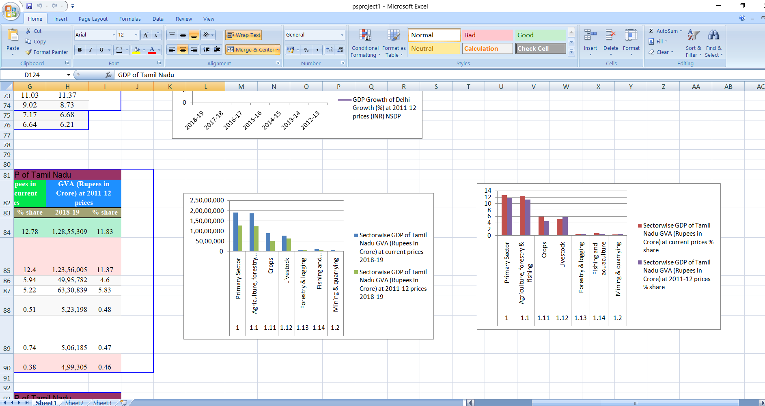

Slide 38
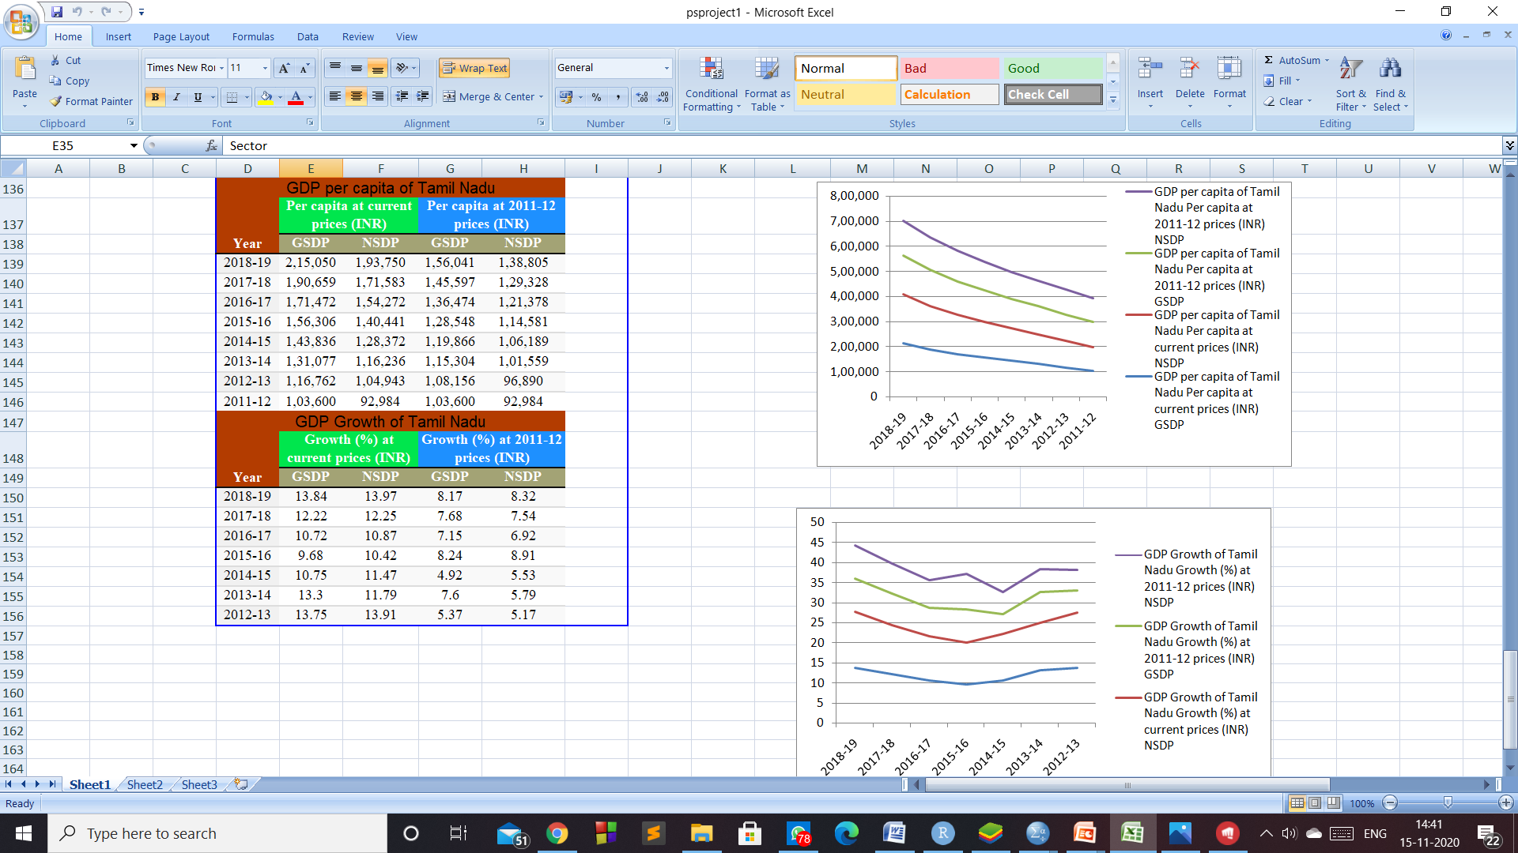

Slide 39
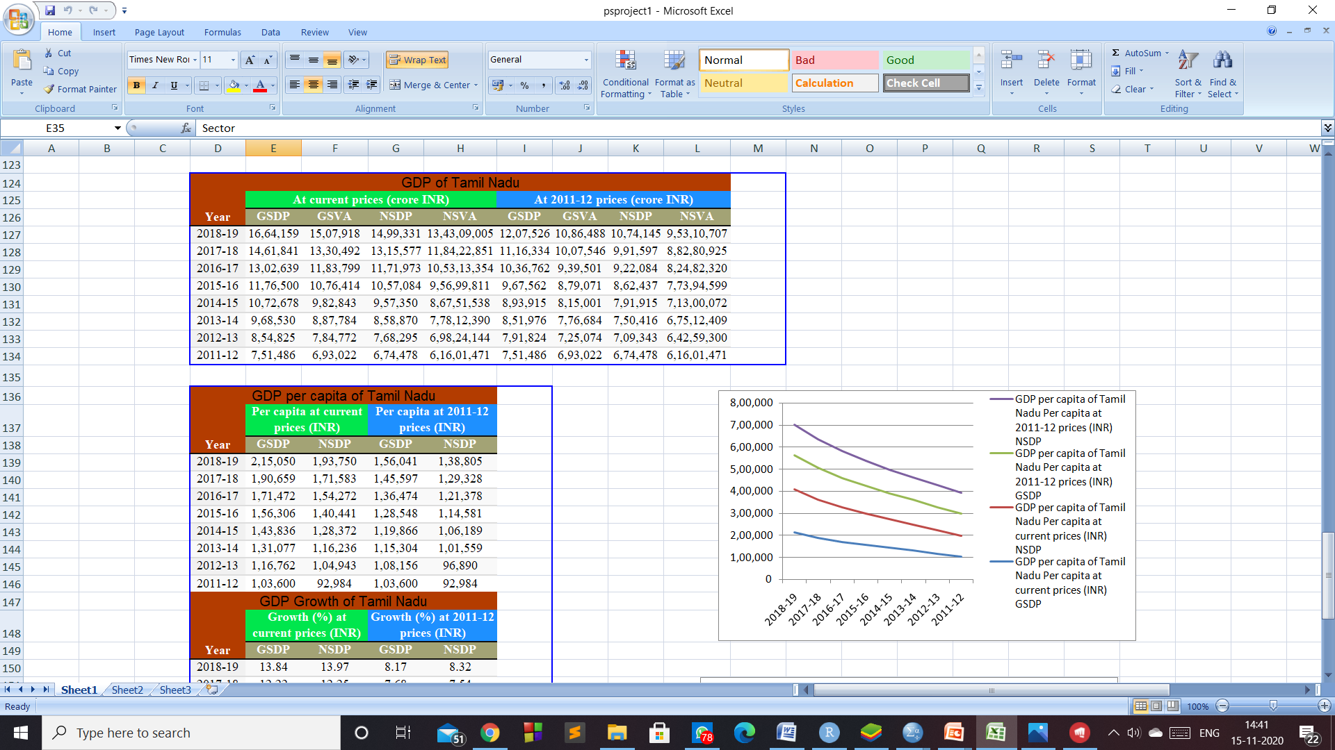

Slide 43
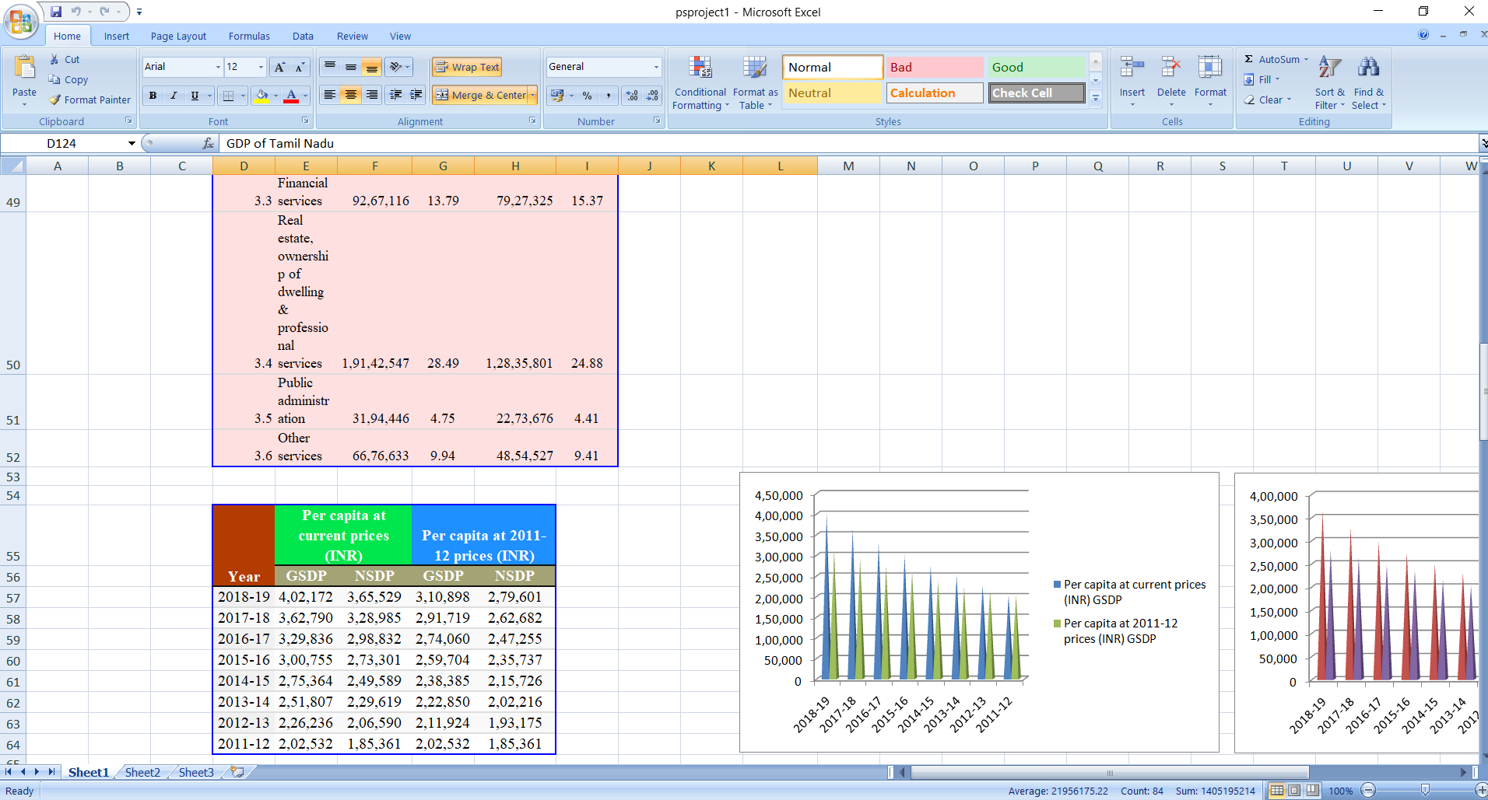

Slide 45
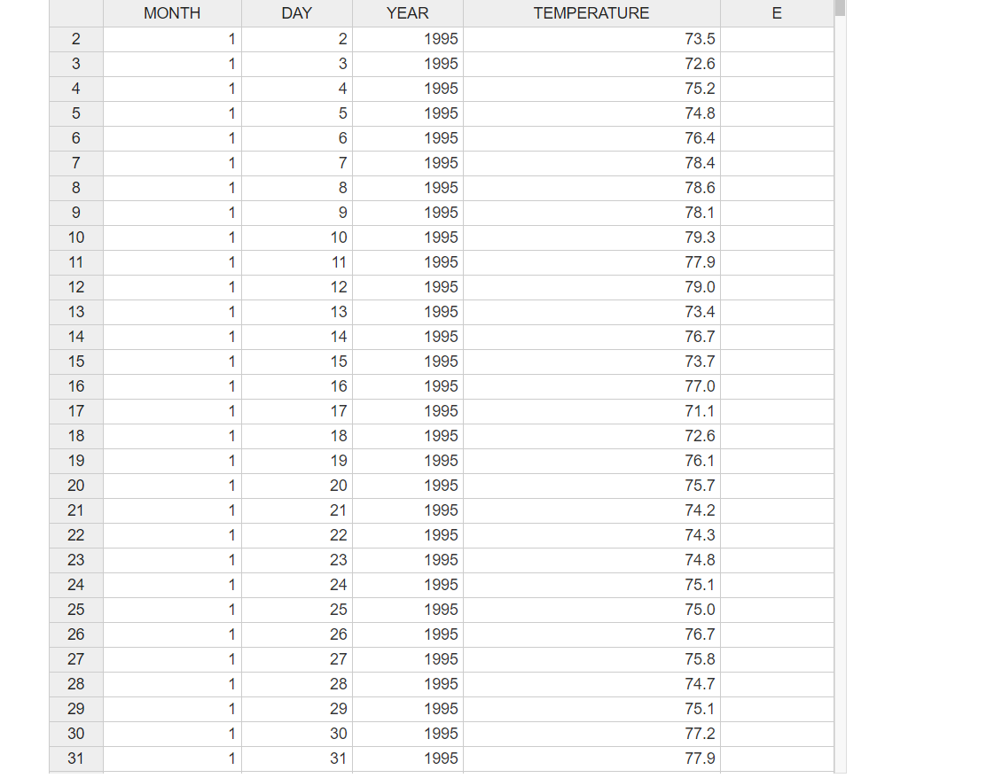
DATA ON TEMPERATURE OF CHENNAI

Slide 46
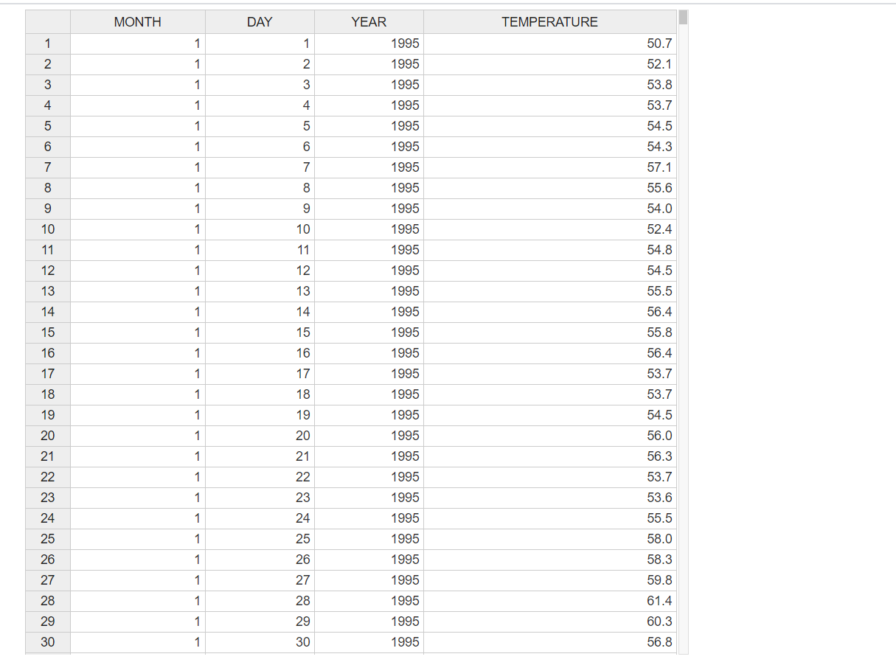
DATA IN TEMPERATURE OF NEW DELHI

Slide 47
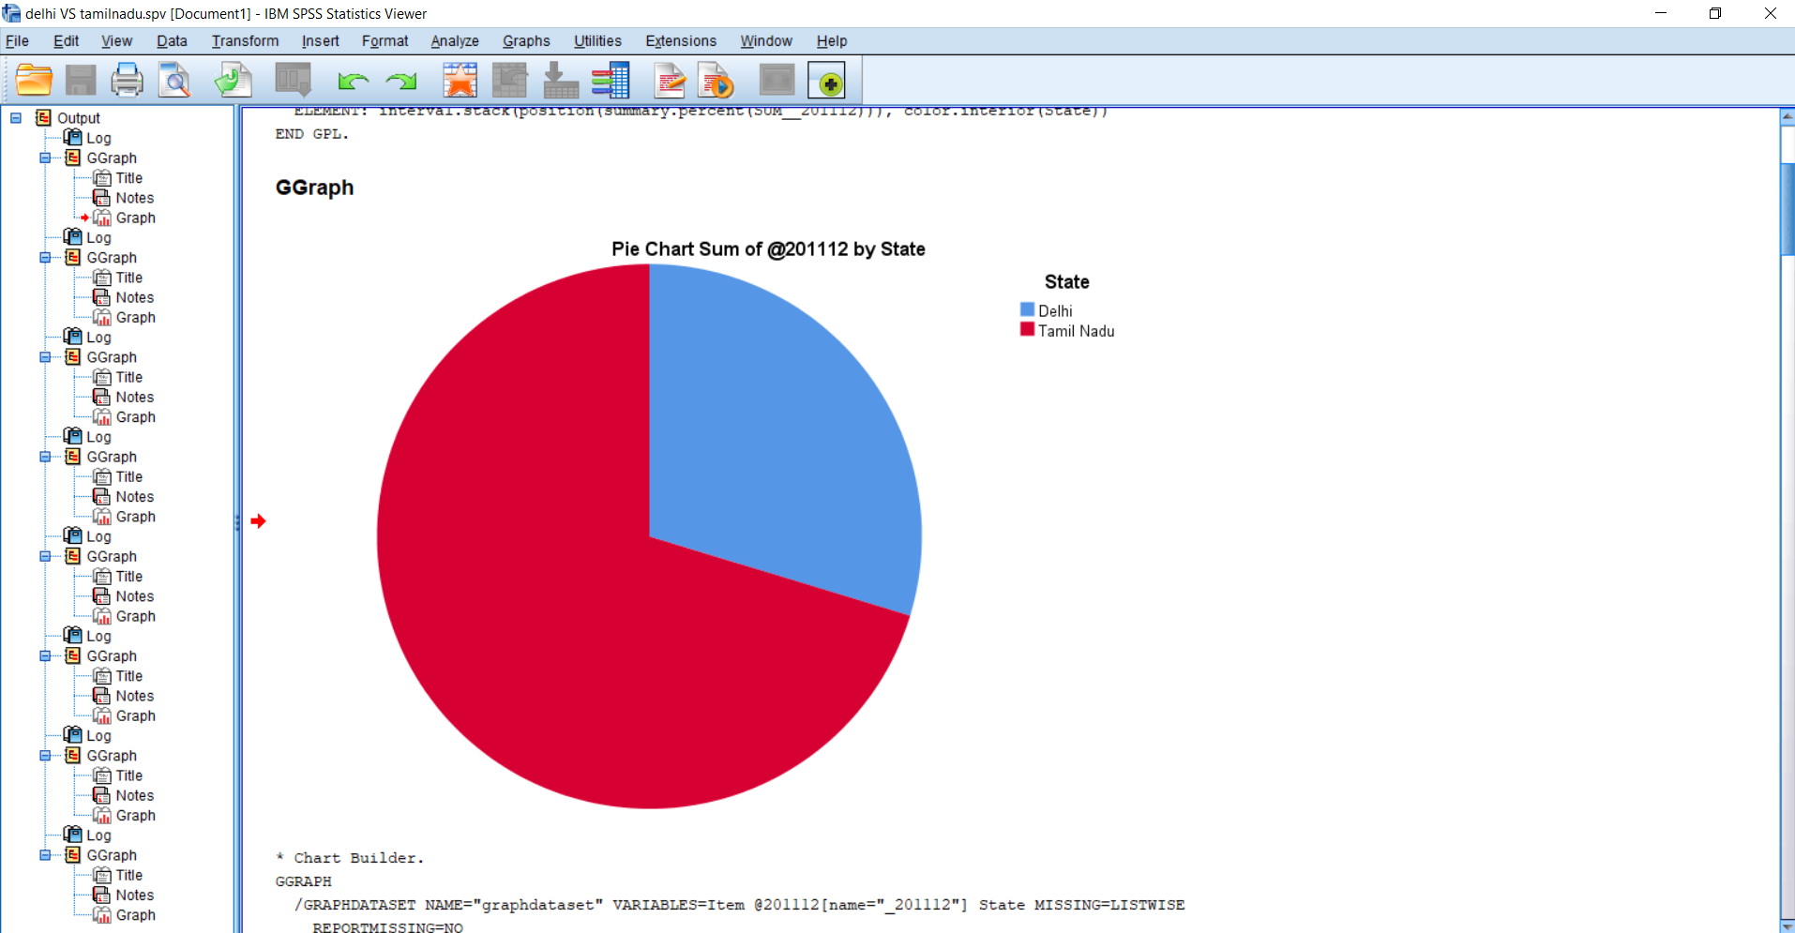
DELHI VS CHENNAI ANALYTIC VIEW

Slide 48
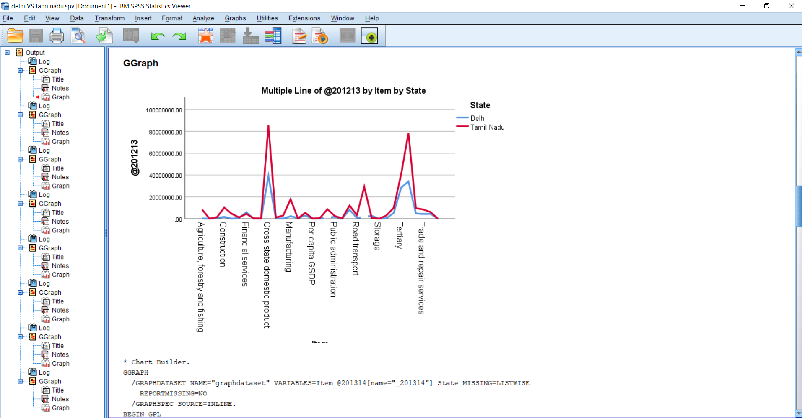

Slide 49
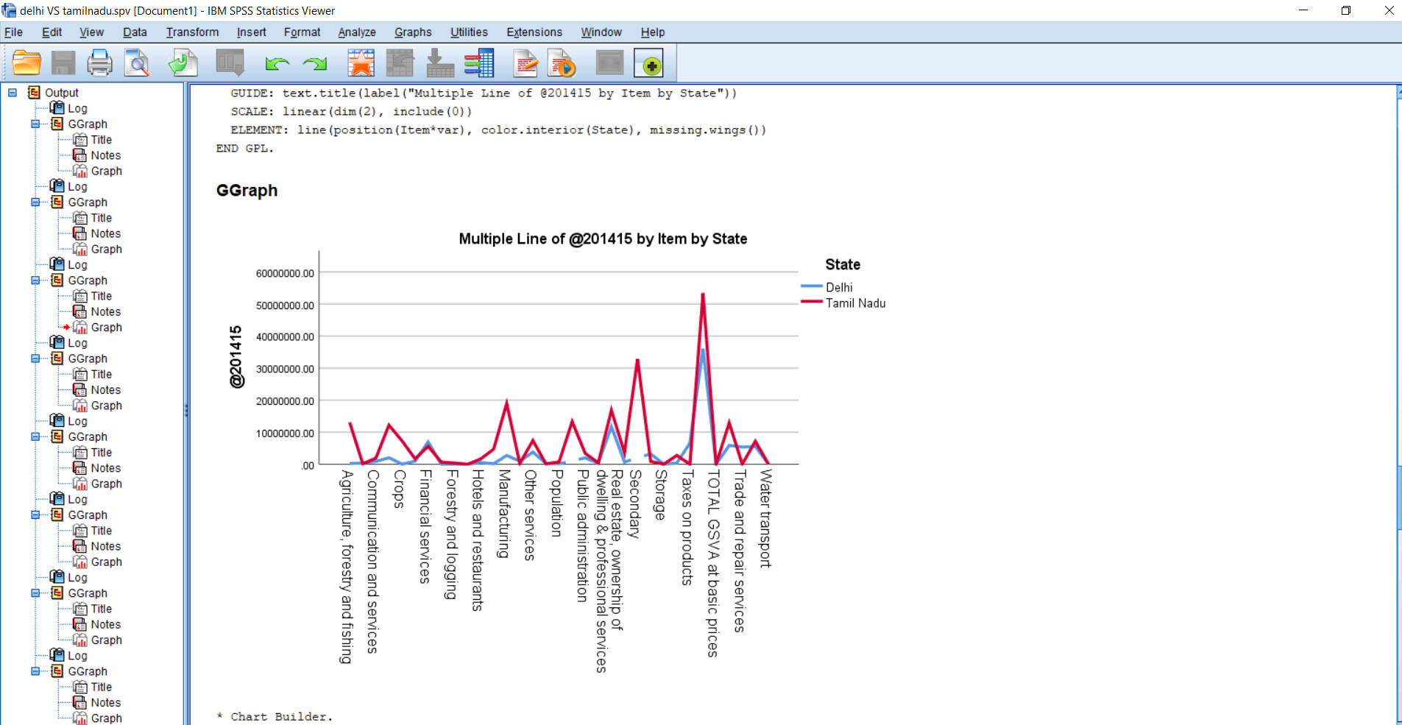

Slide 50
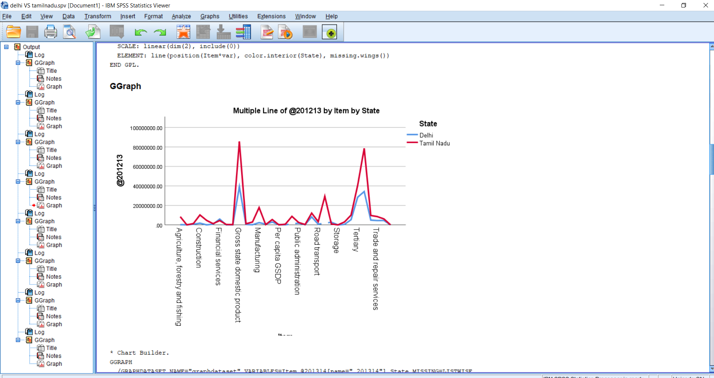

Slide 51
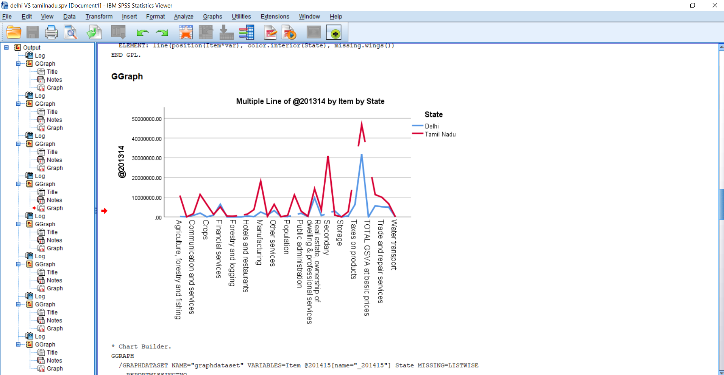

Slide 52
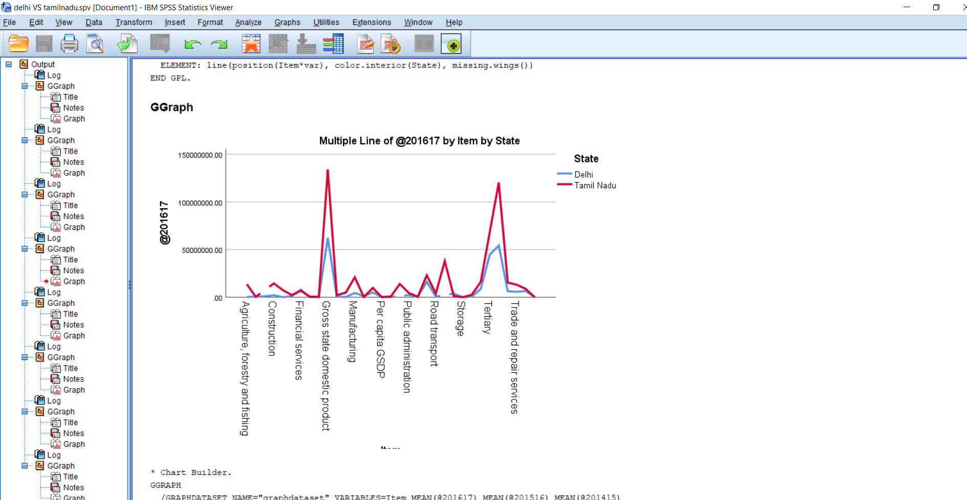

Slide 53
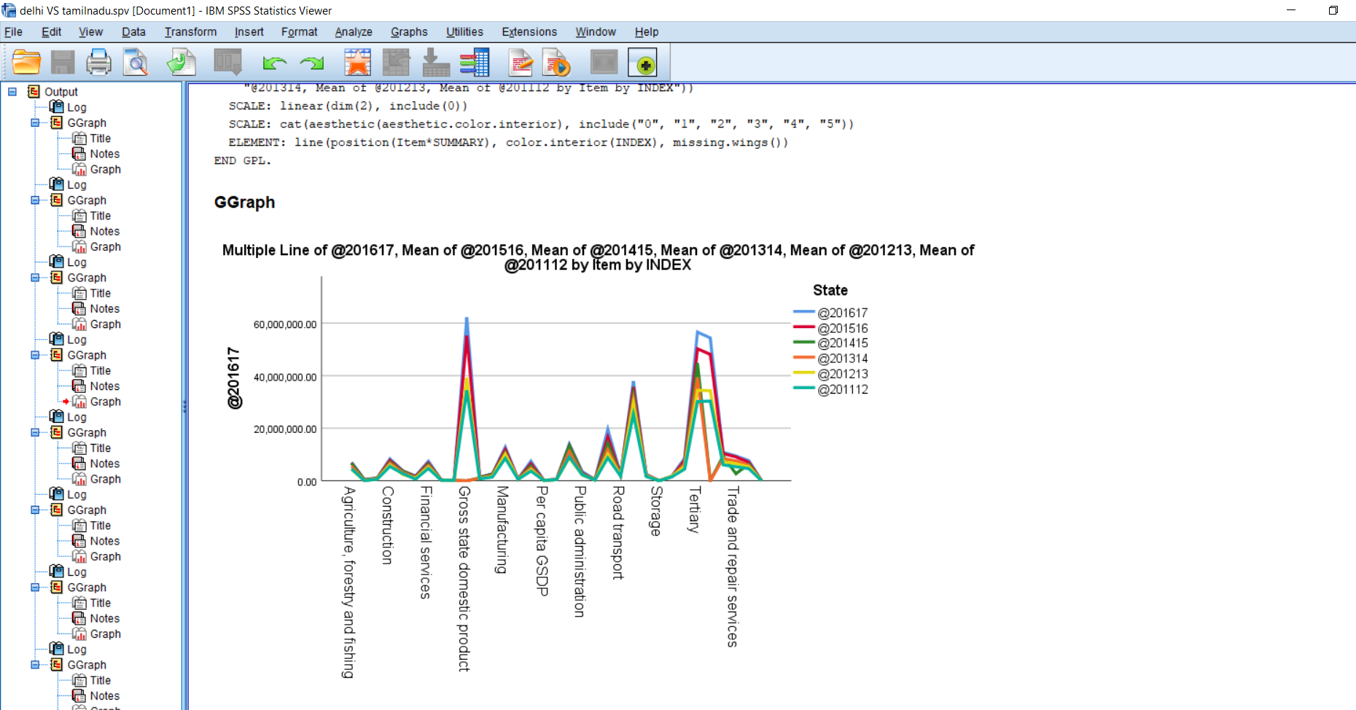

Slide 54
CONCLUSION
The above ppt shows that there is a vast change of progress among the two States in the respective fields in the present century.
But comparing them we obviously find that Tamil Nadu has flourished as compared to New Delhi when it comes to growth in primary secondary and tertiary sector.
THIS shows that the people hailing from the west have worked hard and have been able to keep a margin when it comes to growth in the. Economy of the region when it comes to growth in wealth and power.

Slide 55
Conclusion
This is essential as it will show the various factors have affected to the growth of the south region of country from which theor northern counterpart can grow and lear. This is beneficial for all party involved as this will lead to growth for one and their region in wealth business and growth

